Slide 1

Test Automation
- NIKHIL NASSA

Slide 2
Automation on amazon.com
For this demo, I took amazon.com and ran 4 test cases :
Login
Search
Add to cart
Logout.
Hybrid framework is being used for the automation, as TDD (test driven development) is used to achieve BDD (behaviour driven development). The IDE used for the same is Eclipse IDE. TestNG as test framework, Maven to configure dependencies and POM model as design repository, to enhance code reusability.

Slide 3
Login : First test case
1. Open amazon.com
2. MouseOver to sign in and click on sign in.
3. Popup layer with login page will come, enter username
4. User name entered, enter password and submit.
5. If OTP/Captcha is needed, tackle with “NOT VALID”.
6. Validation of user name with screen name. (Hello Nikhil)
7. Test case run complete.

Slide 4
Search
1. Open amazon.com and login.
2. Click on URL (search bar)
3. Search item (IPHONE) and click on submit.
4. Function (switchtochildwindow) used.
5. Validate Search page and check breadcrums (1/32)
6. Validate result.
7. Test case run complete.

Slide 5
Add to Cart
1. Go to amazon.com and search the Item.
2. Click on first specified item.
3. Click on Add to cart.
4. Validate if selected item present in cart or not.
5. Test case run complete.
Will not proceed to checkout, as it can’t be automated.

Slide 6
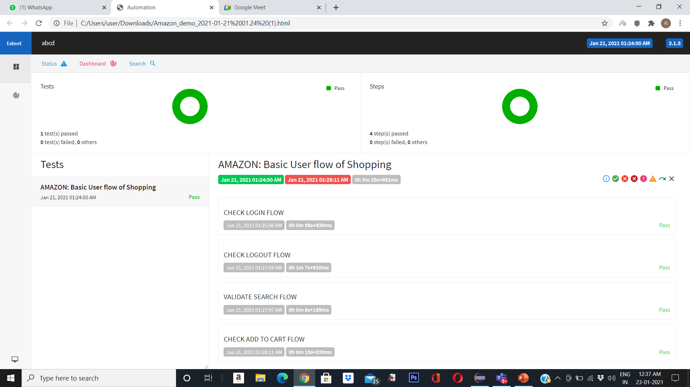
Logout
After the whole Login process, hover to logout and click on logout and validate.

